Slide 1
Josh Awozele
University of Roehampton
B.Eng Software Engineering
Final Year Project

Slide 2
Enhancement of an electronic document management system in a healthcare environment

Slide 3
Scope solution
While typical systems can allow scheduling appointments and receiving messages from healthcare professionals, certain users can use the system to manage their frequency in visits to the GP. The additional features can allows service-users to:
Keep track on when they last visited the GP and if the next visit is a follow-up or a routine visit
Manage their spend at pharmacies so they can understand how much they spend towards prescribed medicines
Click and download features for proof of visit to a GP so that service-users can free-up operation times for other important activities
As a basic security feature: It would be ideal for service-users to know those with access to their own medical record

Slide 4
Aims and objectives
To allow healthcare professionals to focus on service-user’s needs in place of spending complex amount of time on computer systems
To allow users to remotely have access to data they would usually require an appointment for
Monitoring the importance of their visit to ascertain how it betters the health of service-users
To create confidence that only required healthcare professionals can access confidential data related to the needs of service-users

Slide 5
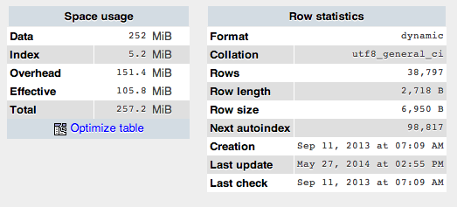





Technical resources
Open source technologies for:
Database development (phpmyadmin)
Front end development
Figma (prototype design)
PHP/Python for user interface
Integrated Development Environment
Sublime/PyCharm
Data visualisation/diagrams
draw.io
Project library/repository
Local drive/MS SharePoint.

Slide 6
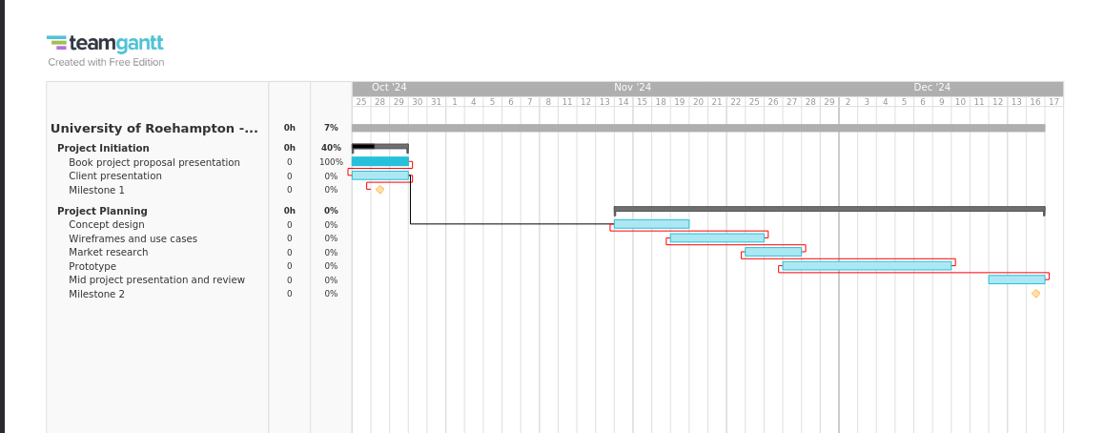
Project timeline

